Slide 1


Slide 2
Team Members:
Marwan Ayman 17107676
Al-Farouk Ahmed 17107672
Ahmed Salem 17107813
Ahmed Samy 17107763
Advanced Programming Applications
CS244
Under the supervision of:
Dr. Passant El-Kafrawy
Eng. Randa Hamdy

Slide 3
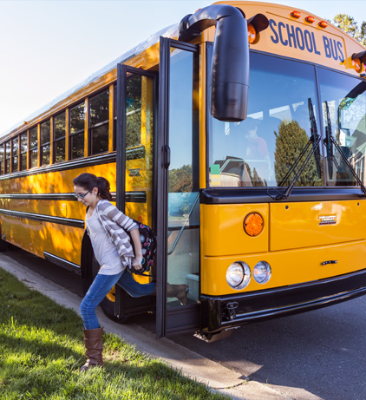
What is Tareeqi ?
Imagine that you can track your bus or your children’s bus using your Smart phone !!

Slide 4
Problems
1st Problem:
Bus riders or the Parents with children using the school bus
often waste a lot of their precious time waiting for the bus.
An average of 15 mins daily.
2nd problem:
Bus supervisors don’t know the location of the buses.
They also receive tons of calls from parents or riders complaining
that the bus is late or that they missed the bus.

Slide 5
Today’s Solutions
Parents have to call the bus driver or the bus attendant
in order to know the bus location and when will it arrive.
Bus supervisors make lots of calls daily ,
asking the drivers about the bus location.
Or entities can apply the normal fleet management
systems which are so expensive.
Now the supervisor can track the buses ,but the
bus users still have the same problem.

Slide 6
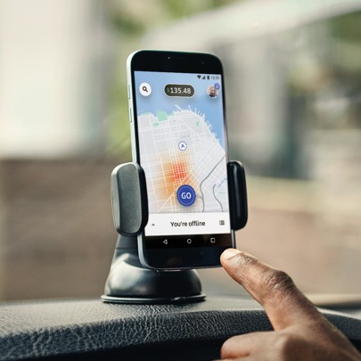
The Idea
When we saw that ride hailing companies use drivers’
smart phones in order to track the car.
And they also share the car location to the passengers
Through the mobile App.
So we had the Idea!!

Slide 7

Research
We’ve made a survey on some entities , And we found that more than 85% of the bus drivers own smart phones.

Slide 8

And we came up with Tareeqi !!!

Slide 9
How will Tareeqi solve the problem??

Slide 10

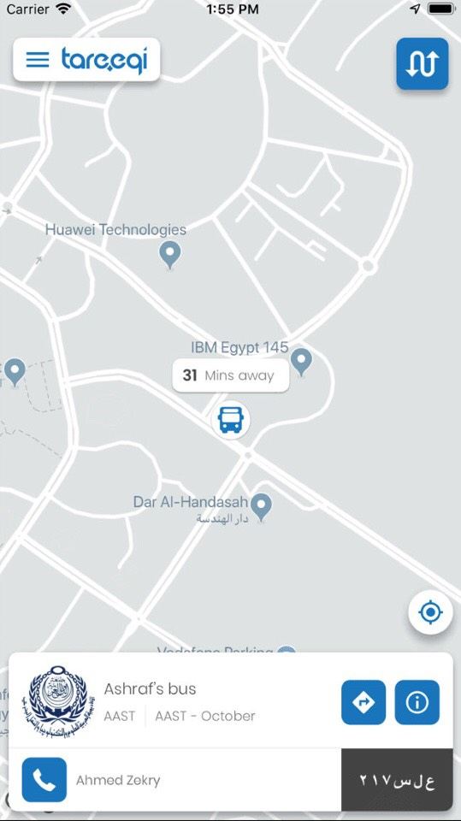

Tareeqi for Passengers:
The passengers’ App allows them to know the current
Location and the exact arrival time of their buses. And
also get notified when the bus arrives.

Slide 11
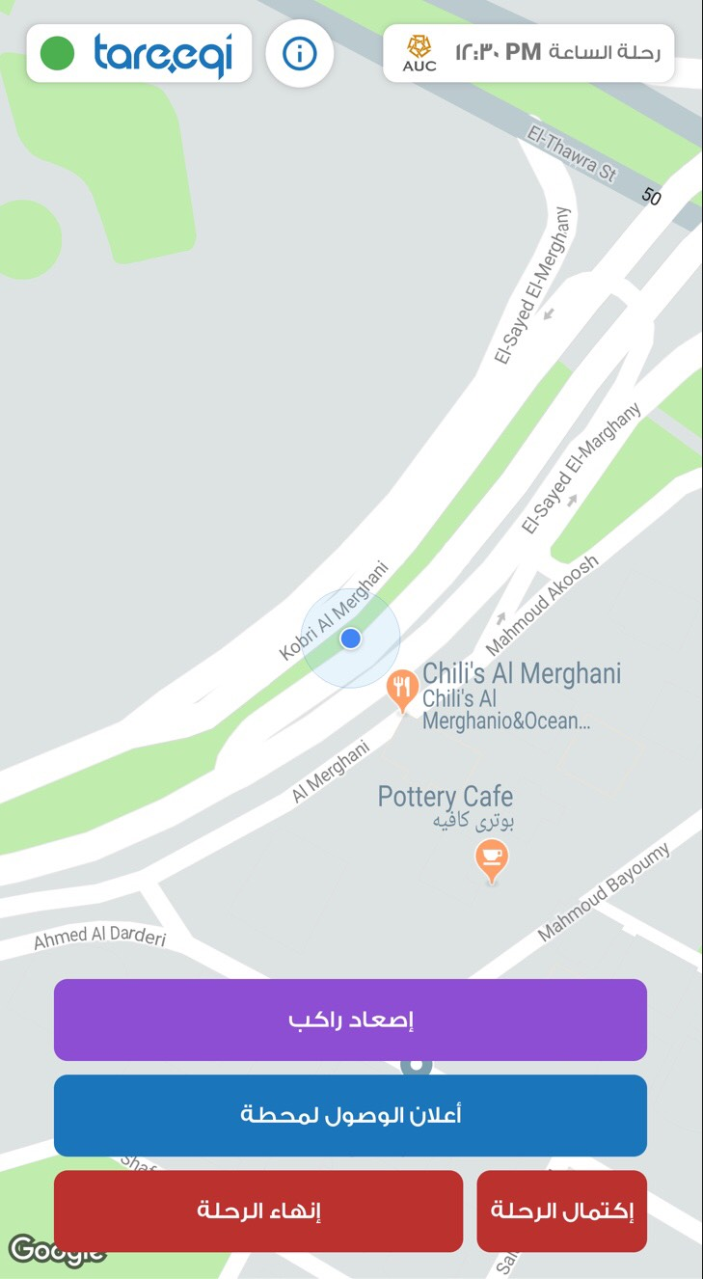

Tareeqi For Drivers:
Drivers see their fastest route, which includes all the
Passengers that they would pick up.
It also shares the location of the bus.

Slide 12
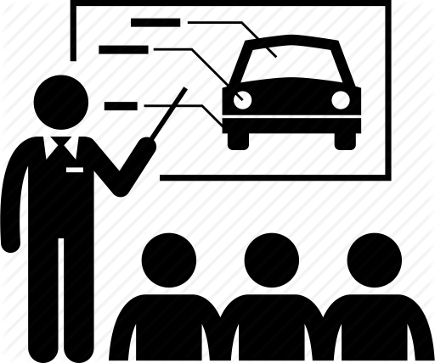
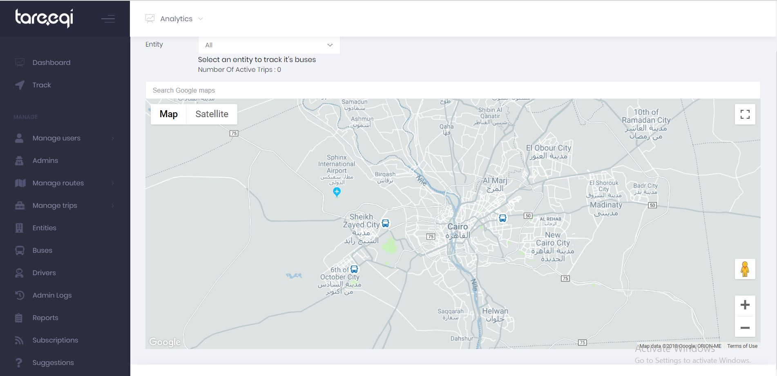
Tareeqi For Instructors:
Instructors Can track the whole bus fleet
& get notified when any bus exceeds
The speed limit.

Slide 13
And all of that without installing any expensive GPS devices.
Only by using the magic of the GPS in the smart phones

Slide 14
Problem Statement
A company built an application that allows parents to track their children’s’ school buses. Information about Users, institutions, buses, trips and stations are stored in the database.
For Each user the company stores: Name (first name & last name), (phone Number & ID) which are his Primary key and his Password.
A User can be Admin, Driver or Parent. Every User must belong to one of the above, and no User can belong to more than one of them.
The company stores additional data of the Driver which is: Trips counter. For each Institution the company stores: Institution ID (which is unique), Name, Location & Phone number. For Each Bus the App stores: Plate Number (which is unique) & Bus Type. And for Each Trip it stores: Trip ID (which is unique), Trip Time & Trip Type. Finally, for Each Station it stores: Station ID (which is unique), Station Name, Station Order & Station Location. Every Institution owns one or more buses, while Each bus is owned by one and only one Institution. Every Admin operates one and only one Institution, while Every Institution is operated by one or many Admins. Every Bus may be driven by one or more Drivers, while Each Driver may drive one or more Buses. Each Driver may start one or more Trips, while Each Trip can only be started by only one Driver. Each Trip has one or more Stations, while each station has one or more trips. Each Parent can Track one or more Trips, while each Trip may be tracked by one or more parents.

Slide 15
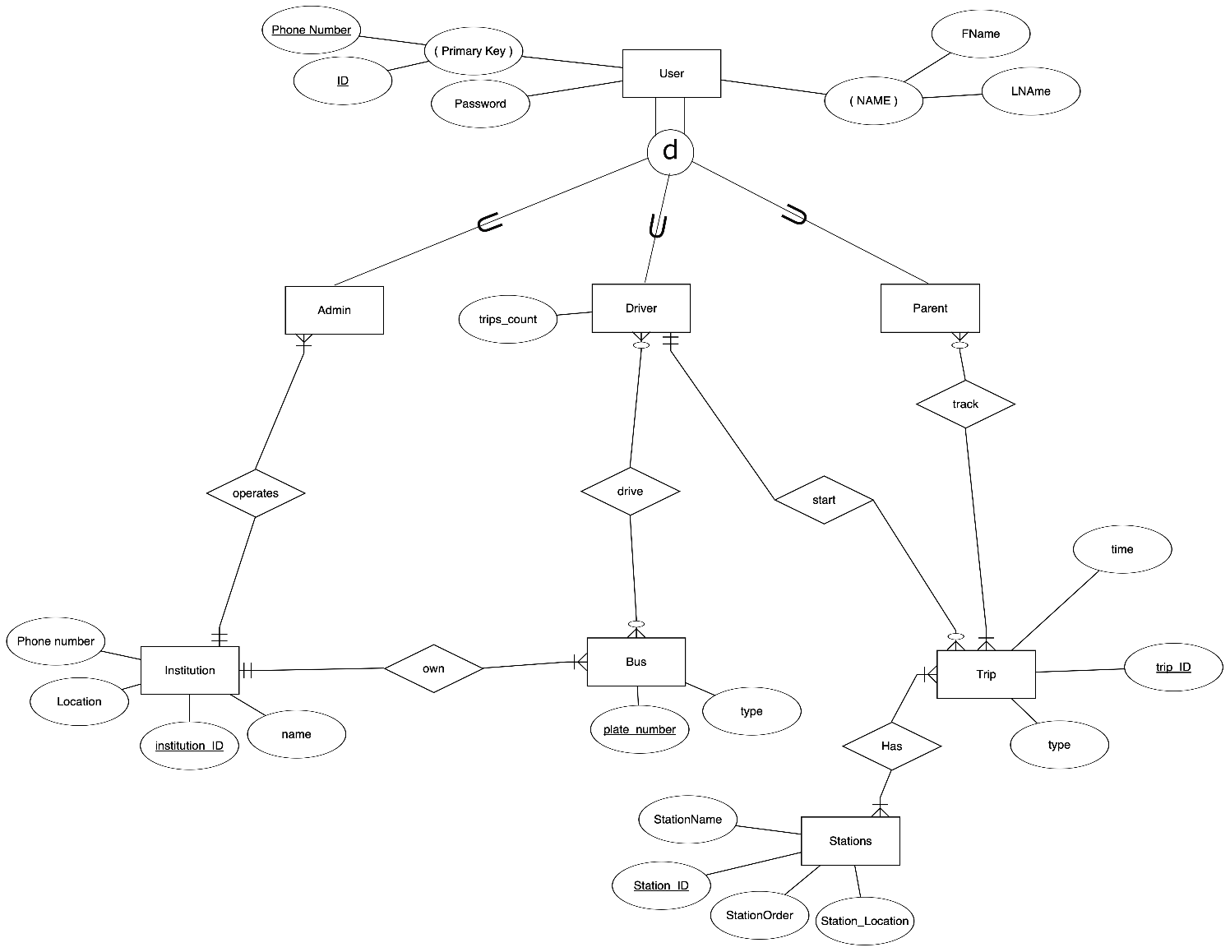
EERD

Slide 16
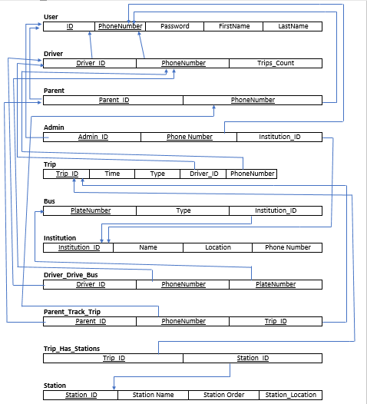
Relational Schema

Slide 17
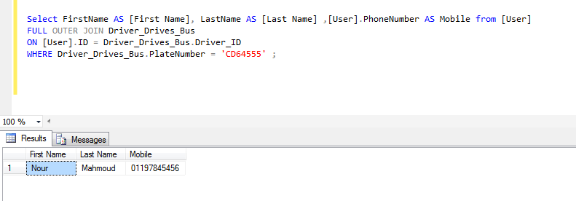
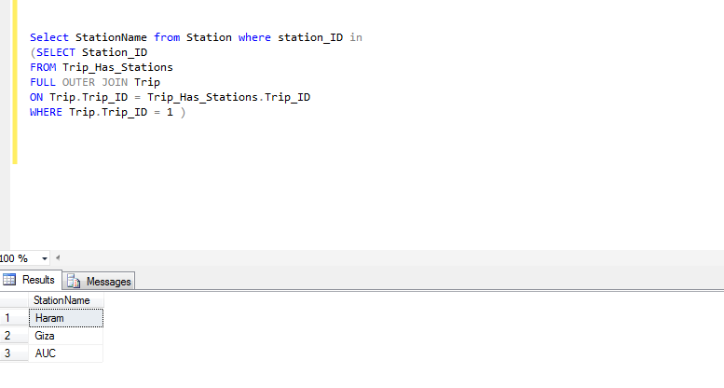
SQL Queries Screenshots

Slide 18
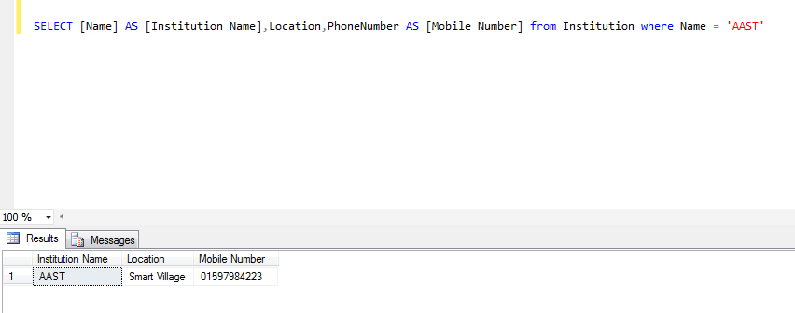
SQL Queries Screenshots (cont.)

Slide 19
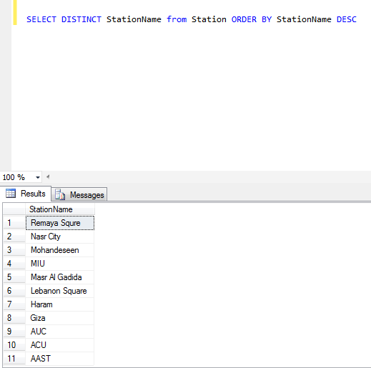
SQL Queries Screenshots (cont.)

Slide 20
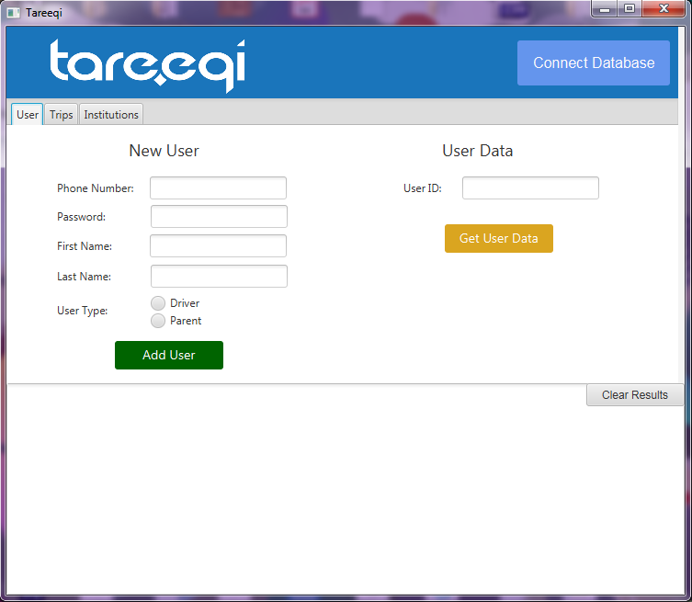
Application Screenshot

Slide 21


